Slide 1
Presentation 21
Software quality metrics
Objectives of quality measurement
Classification of software quality metrics
Process metrics
Product metrics
Implementation of software quality metrics
Limitations of software metrics
The function point method

Slide 2
IEEE definitions of
software quality metrics
(1) A quantitative measure of the degree to which an item possesses a given quality attribute.
(2) A function whose inputs are software data and whose output is a single numerical value that can be interpreted as the degree to which the software possesses a given quality attribute.

Slide 3
Main objectives of
software quality metrics
1. Facilitate management control, planning and managerial intervention.
Based on:
• Deviations of actual from planned performance.
• Deviations of actual timetable and budget
performance from planned.
2. Identify situations for development or maintenance process improvement (preventive or corrective actions). Based on:
• Accumulation of metrics information regarding the
performance of teams, units, etc.

Slide 4
Software quality
metrics — Requirements
General requirements
  Relevant
  Valid
  Reliable
  Comprehensive
  Mutually exclusive
Operative requirements
  Easy and simple
  Does not require independent data collection
  Immune to biased interventions by interested parties

Slide 5
Classifications of
software quality metrics
Classification by phases of software system
Process metrics – metrics related to the software development process
Product metrics – metrics related to software maintenance
Classification by subjects of measuements
Quality
Timetable
Effectiveness (of error removal and maintenance services)
Productivity

Slide 6
Software size (volume) measures
KLOC — classic metric that measures the size of software by thousands of code lines.
Number of function points (NFP) — a measure of the development resources (human resources) required to develop a program, based on the functionality specified for the software system.

Slide 7
Error counted
measures
Number of code errors (NCE) vs. weighted number of code errors (WCE)
 | Calculation of NCE | Calculation of WCE
Error severity class | Number of Errors | Relative Weight | Weighted Errors
a | b | c | D = b x c
low severity | 42 | 1 | 42
medium severity | 17 | 3 | 51
high severity | 11 | 9 | 99
Total | 70 | --- | 192
NCE | 70 | --- | ---
WCE |  | --- | 192

Slide 8
Process metrics categories
Process metrics categories
Software process quality metrics
  Error density metrics
  Error severity metrics
Software process timetable metrics
Software process error removal effectiveness metrics
Software process productivity metrics

Slide 9
Error density metrics
Code | Name | Calculation formula
CED | Code Error Density | NCE CED = ----------- KLOC
DED | Development Error Density | NDE DED = ----------- KLOC
WCED | Weighted Code Error Density | WCE WCDE = --------- KLOC
WDED | Weighted Development Error Density | WDE WDED = --------- KLOC
WCEF | Weighted Code Errors per Function Point | WCE WCEF = ---------- NFP
WDEF | Weighted Development Errors per Function Point | WDE WDEF = ---------- NFP
NCE = The number of code errors detected by code inspections and testing.
NDE = total number of development (design and code) errors) detected in the development process.
WCE = weighted total code errors detected by code inspections and testing.
WDE = total weighted development (design and code) errors detected in development process.

Slide 10
Error severity metrics
Code | Name | Calculation formula
ASCE | Average Severity of Code Errors | WCE ASCE = ----------- NCE
DED | Average Severity of Development Errors | WDE ASDE = ----------- NDE
NCE = The number of code errors detected by code inspections and testing.
NDE = total number of development (design and code) errors) detected in the
development process.
WCE = weighted total code errors detected by code inspections and testing.
WDE = total weighted development (design and code) errors detected in
development process.

Slide 11
Software process
timetable metrics
Code | Name | Calculation formula
TTO | Time Table Observance | MSOT TTO = ----------- MS
ADMC | Average Delay of Milestone Completion | TCDAM ADMC = ----------- MS
MSOT = Milestones completed on time.
MS = Total number of milestones.
TCDAM = Total Completion Delays (days, weeks, etc.) for all milestones.

Slide 12
Error removal
effectiveness metrics
Code | Name | Calculation formula
DERE | Development Errors Removal Effectiveness | NDE DERE = ---------------- NDE + NYF
DWERE | Development Weighted Errors Removal Effectiveness | WDE DWERE = ------------------ WDE+WYF
NDE = total number of development (design and code) errors) detected in the
development process.
WCE = weighted total code errors detected by code inspections and testing.
WDE = total weighted development (design and code) errors detected in
development process.
NYF = number software failures detected during a year of maintenance service.
WYF = weighted number of software failures detected during a year of maintenance
service.

Slide 13
Process productivity
metrics
Code | Name | Calculation formula
DevP | Development Productivity | DevH DevP = ---------- KLOC
FDevP | Function point Development Productivity | DevH FDevP = ---------- NFP
CRe | Code Reuse | ReKLOC Cre = -------------- KLOC
DocRe | Documentation Reuse | ReDoc DocRe = ----------- NDoc
DevH = Total working hours invested in the development of the software system.
ReKLOC = Number of thousands of reused lines of code.
ReDoc = Number of reused pages of documentation.
NDoc = Number of pages of documentation.

Slide 14
Product metrics
categories
* HD quality metrics:
* HD calls density metrics - measured by the number of calls.
* HD calls severity metrics - the severity of the HD issues raised.
* HD success metrics – the level of success in responding to HD calls.
* HD productivity metrics.
* HD effectiveness metrics.
* Corrective maintenance quality metrics.
* Software system failures density metrics
* Software system failures severity metrics
* Failures of maintenance services metrics
* Software system availability metrics
* Corrective maintenance productivity and effectiveness metrics.

Slide 15
HD calls density metrics
Code | Name | Calculation Formula
HDD | HD calls density | NHYC HDD = -------------- KLMC
WHDD | Weighted HD calls density | WHYC WHYC = ------------ KLMC
WHDF | Weighted HD calls per function point | WHYC WHDF = ------------ NMFP
NHYC = the number of HD calls during a year of service.
KLMC = Thousands of lines of maintained software code.
WHYC = weighted HD calls received during one year of service.
NMFP = number of function points to be maintained.

Slide 16
Severity of HD calls metrics
Code | Name | Calculation Formula
ASHC | Average severity of HD calls | WHYC ASHC = -------------- NHYC
NHYC = the number of HD calls during a year of service.
WHYC = weighted HD calls received during one year of service.

Slide 17
HD success metrics
Code | Name | Calculation Formula
HDS | HD service success | NHYOT HDS = -------------- NHYC
NHYNOT = Number of yearly HD calls completed on time during one year of service.
NHYC = the number of HD calls during a year of service.

Slide 18
HD productivity and
effectiveness metrics
Code | Name | Calculation Formula
HDP | HD Productivity | HDYH HDP= -------------- KLNC
FHDP | Function Point HD Productivity | HDYH FHDP = ---------- NMFP
HDE | HD effectiveness | HDYH HDE = -------------- NHYC
HDYH = Total yearly working hours invested in HD servicing of the software system.
KLMC = Thousands of lines of maintained software code.
NMFP = number of function points to be maintained.
NHYC = the number of HD calls during a year of service.

Slide 19
Software system
failures density metrics
Code | Name | Calculation Formula
SSFD | Software System Failure Density | NYF SSFD = -------------- KLMC
WSSFD | Weighted Software System Failure Density | WYF WFFFD = --------- KLMC
WSSFF | Weighted Software System Failures per Function point | WYF WSSFF = ---------- NMFP
NYF = number of software failures detected during a year of maintenance service.
WYF = weighted number of yearly software failures detected during one year of
maintenance service.
NMFP = number of function points designated for the maintained software.
KLMC = Thousands of lines of maintained software code.

Slide 20
Software system failure
severity metrics
Code | Name | Calculation Formula
ASSSF | Average Severity of Software System Failures | WYF ASSSF = -------------- NYF
NYF = number of software failures detected during a year of maintenance service.
WYF = weighted number of yearly software failures detected during one year.

Slide 21
Failures of maintenance
services metrics
Code | Name | Calculation Formula
MRepF | Maintenance Repeated repair Failure metric - | RepYF MRepF = -------------- NYF
NYF = number of software failures detected during a year of maintenance
service.
RepYF = Number of repeated software failure calls (service failures).

Slide 22
Software system
availability metrics
Code | Name | Calculation Formula
FA | Full Availability | NYSerH - NYFH FA = ----------------------- NYSerH
VitA | Vital Availability | NYSerH - NYVitFH VitA = ----------------------------- NYSerH
TUA | Total Unavailability | NYTFH TUA = ------------ NYSerH
NYSerH = Number of hours software system is in service during one year.
NYFH = Number of hours where at least one function is unavailable (failed) during one year,
including total failure of the software system.
NYVitFH = Number of hours when at least one vital function is unavailable (failed) during
one year, including total failure of the software system.
NYTFH = Number of hours of total failure (all system functions failed) during one year.
NYFH ≥ NYVitFH ≥ NYTFH.
1 – TUA ≥ VitA ≥FA

Slide 23
Software corrective
maintenance productivity
and effectiveness metrics
Code | Name | Calculation Formula
CMaiP | Corrective Maintenance Productivity | CMaiYH CMaiP = --------------- KLMC
FCMP | Function point Corrective Maintenance Productivity | CMaiYH FCMP = -------------- NMFP
CMaiE | Corrective Maintenance Effectiveness | CMaiYH CMaiE = ------------ NYF
CMaiYH = Total yearly working hours invested in the corrective maintenance of the software
system.
NYF = number of software failures detected during a year of maintenance service.
NMFP = number of function points designated for the maintained software.
KLMC = Thousands of lines of maintained software code.

Slide 24
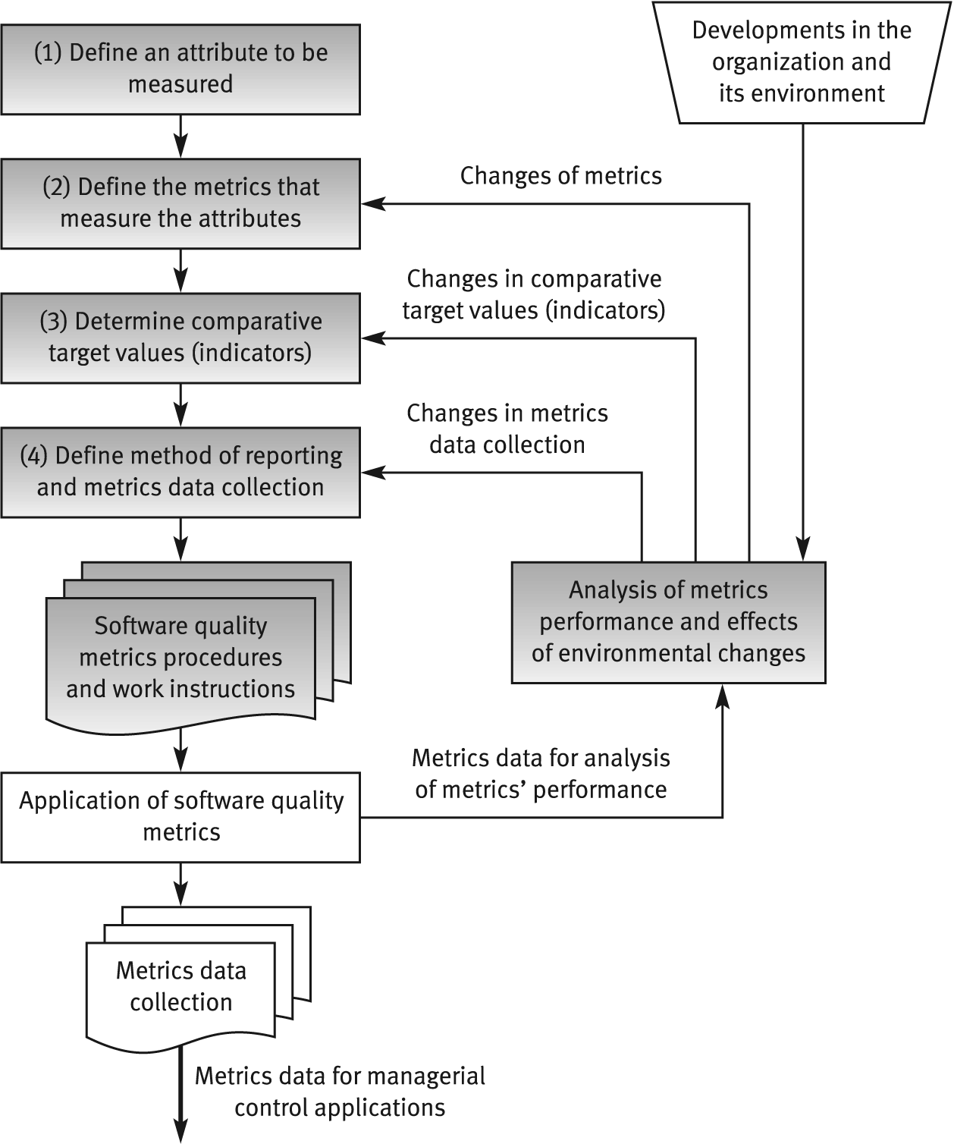
The process of
defining software quality metrics

Slide 25
General limitations of
quality metrics
* Budget constraints in allocating the necessary resources.
* Human factors, especially opposition of employees to evaluation of their activities.
* Validity Uncertainty regarding the data's, partial and biased reporting.

Slide 26
Examples of software
metrics that exhibit
severe weaknesses
* Parameters used in development process
metrics:
KLOC, NDE, NCE.
* Parameters used in product (maintenance)
metrics:
KLMC, NHYC, NYF.

Slide 27
Factors affecting parameters
used for development
process metrics
a. Programming style (KLOC).
b. Volume of documentation comments (KLOC).
c. Software complexity (KLOC, NCE).
d. Percentage of reused code (NDE, NCE).
e. Professionalism and thoroughness of design review and software testing teams: affects the number of defects detected (NCE).
f. Reporting style of the review and testing results: concise reports vs. comprehensive reports (NDE, NCE).

Slide 28
Factors affecting
parameters used for product
(maintenance) metrics
a. Quality of installed software and its documentation (NYF, NHYC).
b. Programming style and volume of documentation comments included in the code be maintained (KLMC).
c. Software complexity (NYF).
d. Percentage of reused code (NYF).
e. Number of installations, size of the user population and level of applications in use: (NHYC, NYF).

Slide 29
The function point method
The function point method
The function point estimation process:
Stage 1: Compute crude function points (CFP).
Stage 2: Compute the relative complexity adjustment factor (RCAF) for the project. RCAF varies between 0 and 70.
Stage 3: Compute the number of function points (FP):
FP = CFP x (0.65 + 0.01 x RCAF)

Slide 30
Crude function points
(CFP) – calculation form
Software system components | Complexity level |  |  |  |  |  |  |  |  | Total CFP
 | Simple |  |  | average |  |  | complex
 | Count | Weight Factor | Points | Count | Weight Factor | Points | Count | Weight Factor | Points
 | A | B | C= AxB | D | E | F= DxE | G | H | I= GxH
User inputs |  | 3 |  |  | 4 |  |  | 6
User outputs |  | 4 |  |  | 5 |  |  | 7
User online queries |  | 3 |  |  | 4 |  |  | 6
Logical files |  | 7 |  |  | 10 |  |  | 15
External interfaces |  | 5 |  |  | 7 |  |  | 10
Total CFP

Slide 31
Relative complexity
adjustment factor (RCAF) – form
No | Subject | Grade
1 | Requirement for reliable backup and recovery | 0 1 2 3 4 5
2 | Requirement for data communication | 0 1 2 3 4 5
3 | Extent of distributed processing | 0 1 2 3 4 5
4 | Performance requirements | 0 1 2 3 4 5
5 | Expected operational environment | 0 1 2 3 4 5
6 | Extent of online data entries | 0 1 2 3 4 5
7 | Extent of multi-screen or multi-operation online data input | 0 1 2 3 4 5
8 | Extent of online updating of master files | 0 1 2 3 4 5
9 | Extent of complex inputs, outputs, online queries and files | 0 1 2 3 4 5
10 | Extent of complex data processing | 0 1 2 3 4 5
11 | Extent that currently developed code can be designed for reuse | 0 1 2 3 4 5
12 | Extent of conversion and installation included in the design | 0 1 2 3 4 5
13 | Extent of multiple installations in an organization and variety of customer organizations | 0 1 2 3 4 5
14 | Extent of change and focus on ease of use | 0 1 2 3 4 5
 | Total = RCAF

Slide 32
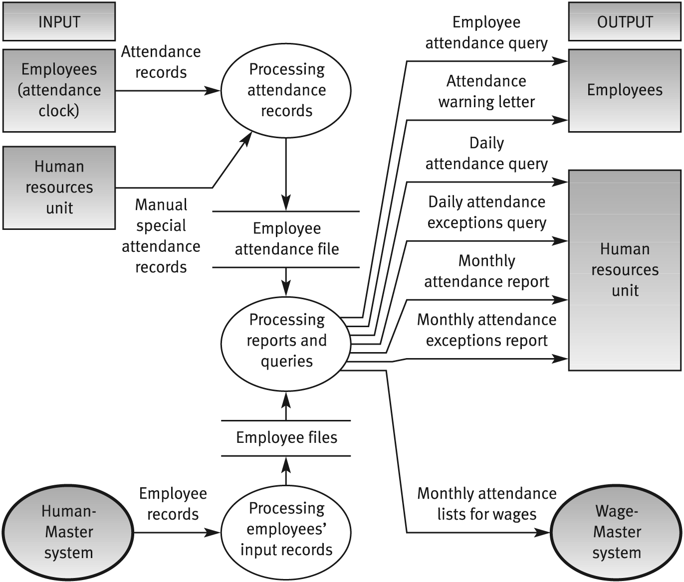
The ATTEND MASTER -
Data Flow Diagram

Slide 33
The ATTEND MASTER
CFP calculation form
Software system components | Complexity level |  |  |  |  |  |  |  |  | Total CFP
 | Simple |  |  | average |  |  | complex
 | Count | Weight Factor | Points | Count | Weight Factor | Points | Count | Weight Factor | Points
 | A | B | C= AxB | D | E | F= DxE | G | H | I= GxH
User inputs | 1 | 3 | 3 | --- | 4 | --- | 1 | 6 | 6 | 9
User outputs | --- | 4 | --- | 2 | 5 | 10 | 1 | 7 | 7 | 17
User online queries | 1 | 3 | 3 | 1 | 4 | 4 | 1 | 6 | 6 | 13
Logical files | 1 | 7 | 7 | --- | 10 | --- | 1 | 15 | 15 | 22
External interfaces | --- | 5 | --- | --- | 7 | --- | 2 | 10 | 20 | 20
Total CFP |  |  |  |  |  |  |  |  |  | 81

Slide 34
The ATTEND MASTER
RCAF calculation form
No | Subject | Grade
1 | Requirement for reliable backup and recovery | 0 1 2 3 4 5
2 | Requirement for data communication | 0 1 2 3 4 5
3 | Extent of distributed processing | 0 1 2 3 4 5
4 | Performance requirements | 0 1 2 3 4 5
5 | Expected operational environment | 0 1 2 3 4 5
6 | Extent of online data entries | 0 1 2 3 4 5
7 | Extent of multi-screen or multi-operation online data input | 0 1 2 3 4 5
8 | Extent of online updating of master files | 0 1 2 3 4 5
9 | Extent of complex inputs, outputs, online queries and files | 0 1 2 3 4 5
10 | Extent of complex data processing | 0 1 2 3 4 5
11 | Extent that currently developed code can be designed for reuse | 0 1 2 3 4 5
12 | Extent of conversion and installation included in the design | 0 1 2 3 4 5
13 | Extent of multiple installations in an organization and variety of customer organizations | 0 1 2 3 4 5
14 | Extent of change and focus on ease of use | 0 1 2 3 4 5
 | Total = RCAF | 41

Slide 35
The ATTEND MASTER – function points calculation
The ATTEND MASTER – function
points calculation
FP = CFP x (0.65 + 0.01 x RCAF)
FP = 81 x (0.65 + 0.01 x 41) = 85.86

Slide 36
The function point method –
advantages and disadvantages
Main advantages
Estimates can be prepared at the pre-project stage.
Based on requirement specification documents (not specific dependent on development tools or programming languages), the method’s reliability is relatively high.
Main disadvantages
FP results depend on the counting instruction manual.
Estimates based on detailed requirements specifications, which are not always available.
The entire process requires an experienced function point team and substantial resources.
The evaluations required result in subjective results.
Successful applications are related to data processing. The method cannot yet be universally applied.

